Slide 1


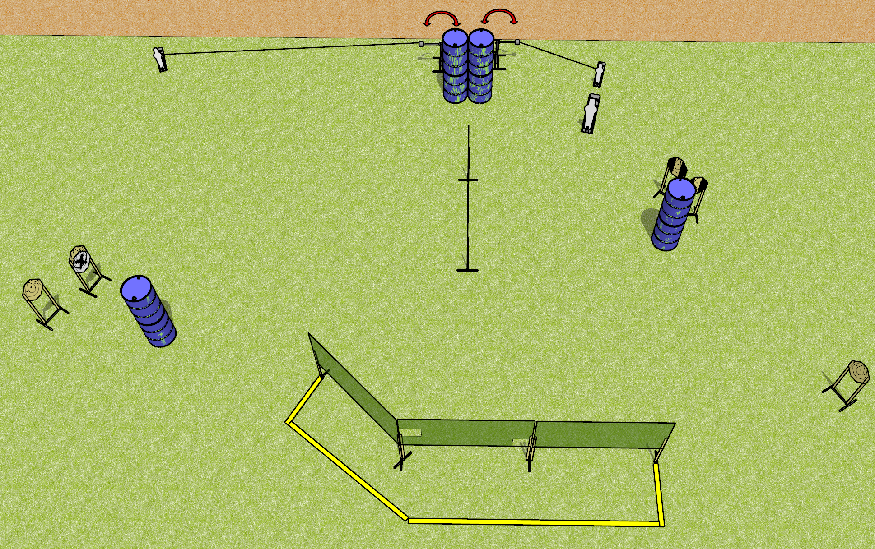
 | Dothan Gun Club – USPSA Match No More Funny Business Course Designer : Drew Coleman
Round Count 17 rounds 7 IPSC 1 PP, 2 MP
Equipment List 7 wall feet 2 swingers + activators 2 tux + 6 targets (5 scoring + 1 NS)

Slide 2
No More Funny Business
Written Stage Briefing
No More Funny Business is a 17 round, 85 point, Comstock course of fire. There are 7 IPSC targets and 3 steel. The best 2 hits on cardboard will score and steel must fall to score.
The swingers are activated by poppers and remain visible at rest.
Handgun start position is hands touching marks. Handgun is loaded and holstered.
PCC start position is muzzle touching either mark, stock on belt. Loaded carbine is held with both hands, safety on.
On the audible start signal, engage targets as they become available from within the shooting area.

